Slide 1
Relation Extraction
different ways for chinese relation extraction
Zhizhen Zhang
Intern
June 2020

Slide 2
Learning
Objectives
Task background and a brief introduction
Current related works
How we can use these works in our tasks

Slide 3
Task background and a brief introduction

Slide 4
Problem Definition
Definitions
Given two entity mentions, identify relations and classify them into predefined types.
Identifying different expressions of a relation is important
Measurements
Metrics: Precision, Recall and F1.
loss function: softmax with cross-entropy loss(most)
Keywords
Relation extraction, relation classification

Slide 5
Usage Scenarios
Scenario 1
The entity relationship extraction task is an important subtask in information extraction
Scenario 2
It is also an essential link in the process of constructing knowledge graph

Slide 6
Current related works

Slide 7
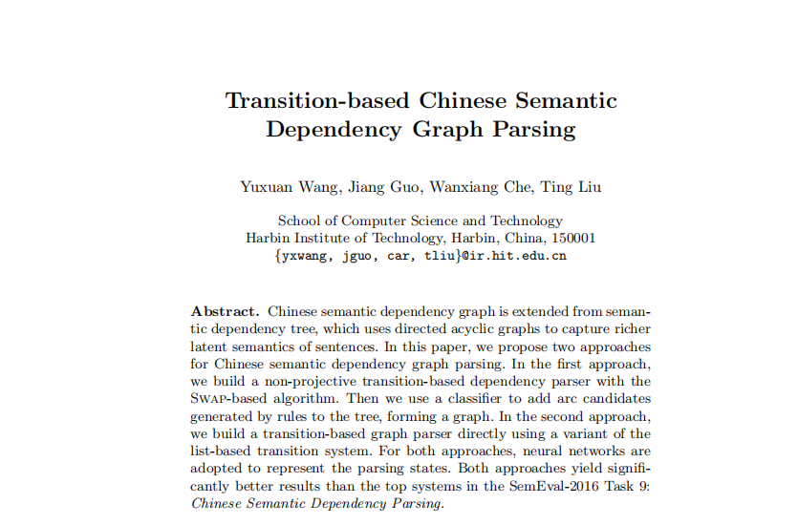
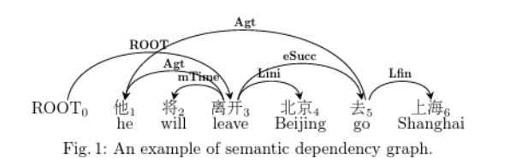
Related work 1: Yuxuan Wang; CCL; 2016
Main ideas (think about why this paper could be published, what particular problems the researchers solved, and why this approach outperforms other approaches at that time )
Propose a transition-based dependency parser that produce dependency graphs directly
Besides baseline features, they add some non-local features including valency, distance and cluster
Notes:
基于转移的语义依存图，将句子的解码过程建模为一个有限自动机问题。目标是训练一个分类器。这个分类器对给定转移状态预测下一步要执行的转移动作。

Slide 8
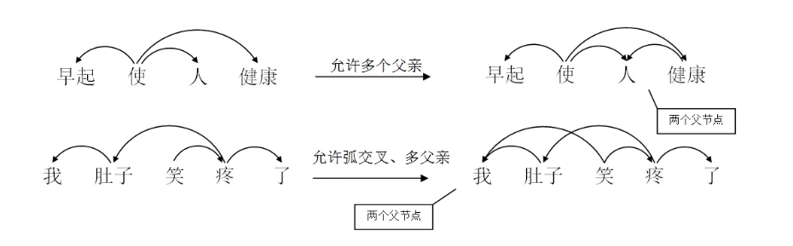
在依存树中，任何一个成分都不能依存于两个或两个以上的成分，而在依存图中则允许句中成分依存于两个或两个以上的成分。且在依存图中允许依存弧之间存在交叉，而依存树中不允许

Slide 9
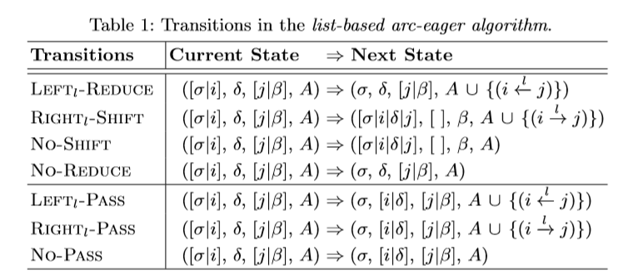
We use a tuple (σ,δ,β,A) to represent each of the parsing state, where σ is a stack holding processed words, δ is a stack holding words popped out of σ that will be pushed back in the future, and β is a buﬀer holding unprocessed words. A is a set of labeled dependency arcs.
Leftl-∗ and Rightl-∗ add an arc with label l from wj to wi, and vice versa. These transitions are performed only when one of wi and wj is the head of the other. Otherwise, No∗ will be performed.
∗-Shift is performed when no dependency exists between wj and any word in σ other than wi, which pushes all words in δ and wj into σ.
∗-Reduce is performed only when wi has head and is not the head or child of any word in β, which pops wi out of σ.
∗-Pass is performed when neither ∗-Shift nor ∗-Reduce can be performed, which moves wi to the front of δ.

Slide 10
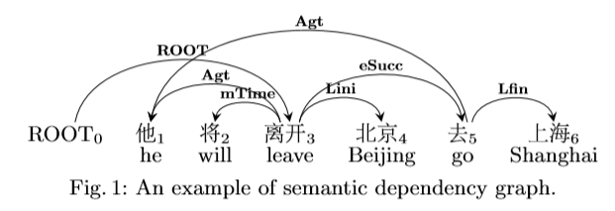
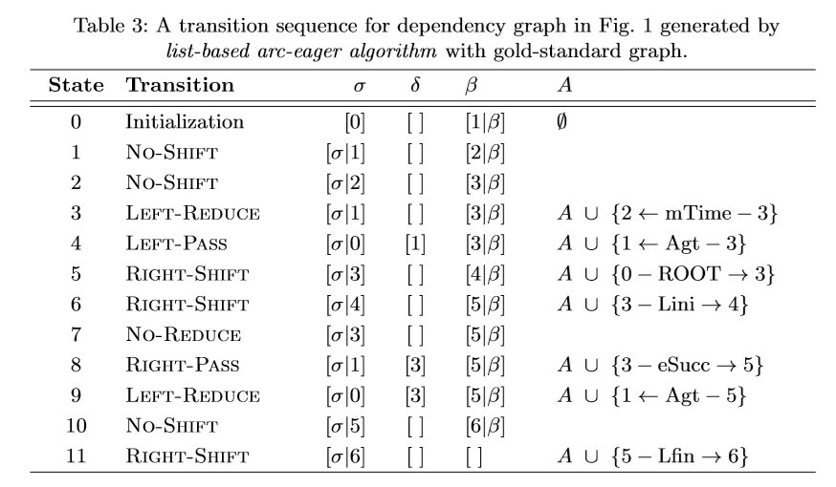

Slide 11
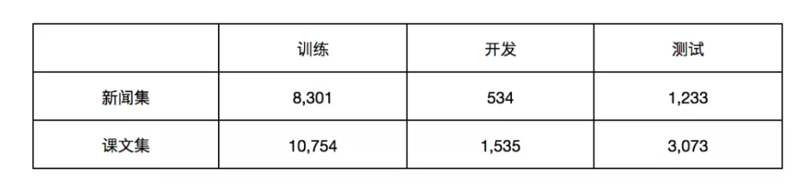
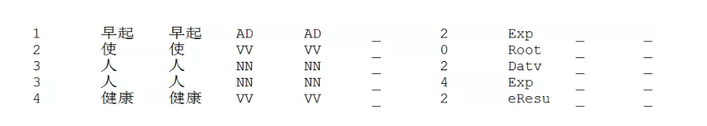
Related work 1: Yuxuan Wang; CCL; 2016
包含10,068句新闻句子（NEWS）和15,362句课文句子（TEXTBOOKS）。新闻句子平均长度是31个词，课文句子平均长度是14个词。
数据格式采用CoNLLX格式，其中第1列是词序号，第2列是词，第4列是词性，第7列是父节点序号（0表示父节点为虚拟根节点），第8列是当前词与父节点之间的语义关系（弧标签）。（在CoNLLX格式中第3列是词根，由于中文没有词根信息因此与第2列相同。第4、5列分别是粗粒度和细粒度词性，这里只有一种词性，因此这两列相同。）用多个具有相同词序号的行表示多父节点情况，每一行记录该词一个父节点的信息。
Notes:
NLF：有多父系节点的弧标签的F1值

Slide 12
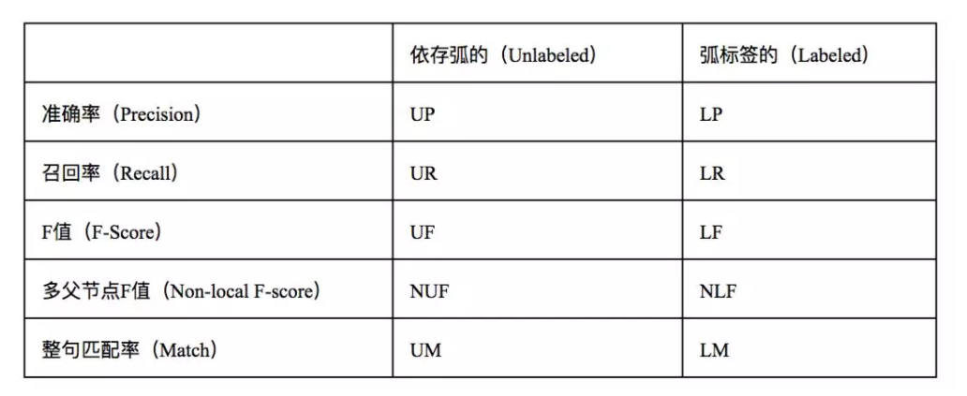
其中最重要的两项是LF和NLF，分别代表了整体的弧标签F值和多父节点词的弧标签F值，其中后者对于图结构分析尤为重要，因为只有图结构中才允许多父节点词的出现。
Objectives
In labeled parsing task like semantic dependency parsing, the number of transitions that generate arcs (Leftl-∗, Rightl-∗) equals to the number of label classes
Models
Tree+SVM, List-based, Simplified

Slide 13
Related work 1: Yuxuan Wang; CCL; 2016
Results
The first approach (Tree+SVM) has the best performance in LF and UF but worst in NLF. However, its NUF is higher than others. It is mainly due to the low precision of the SVM classifier, resulting from the small amount of the positive training samples.
In the second approach (dependency graph parser), with lower NUF, we present much higher NLF scores, showing the high precision of dependency label prediction.This is because the labeling part is trained with all samples rather than non-local samples alone in dependency graph parser.
All of their systems perform better with richer non-local features.
Limitations
The first approach requires extra human knowledge to design preprocessing rules.

Slide 14
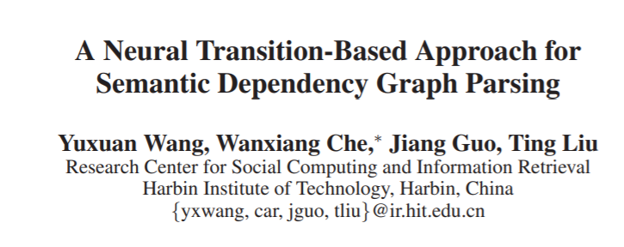
Related work 1.1: Yuxuan Wang; AAAI; 2018

Slide 15
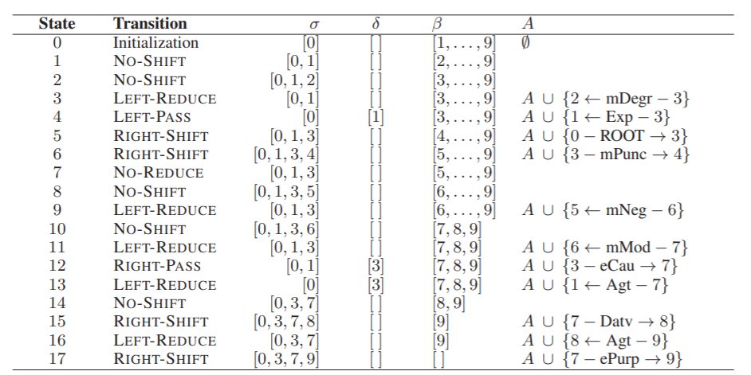
Transition process

Slide 16
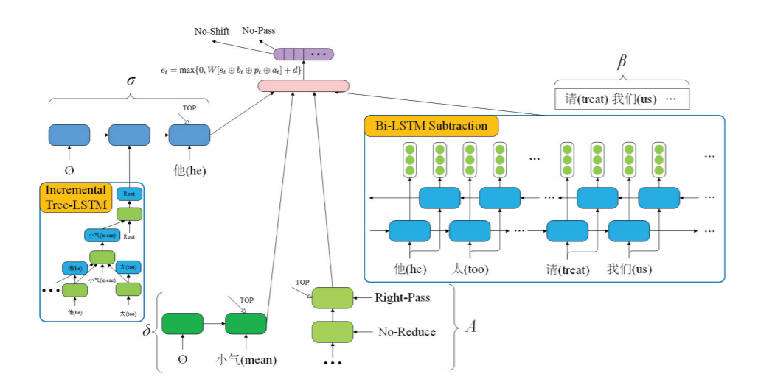
Representations of the four components are then concatenated and passed through a hidden layer to obtain the representation of the parsing state at time t.
where st, bt, pt and at are the representation of σ, β, δ and A respectively. d is the bias. ⊕ is the concatenation operator. et is finally used to compute the probability distribution of possible transition actions at time t through a softmax layer.

Slide 17
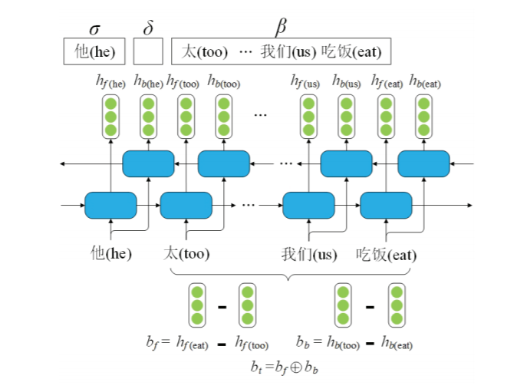
Bi-LSTM Subtraction
They regard the buffer as a segment and use the subtraction between LSTM hidden vectors of the segment head and tail as its representation.
To include the information of words out of the buffer, they apply subtraction on bidirectional LSTM representations over the whole sentence.

Slide 18
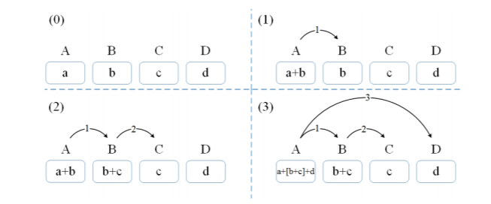
Incremental Tree-LSTM
Each time a dependency arc is generated, we collect representations of all the found modifiers of the head and combine them along with the embedding of the head as the representation of the sub-graph.
Limitation: if the dependency between A and D is not generated, then the final representation of the sub-graph will be the combination of embeddings of A and B without C.

Slide 19
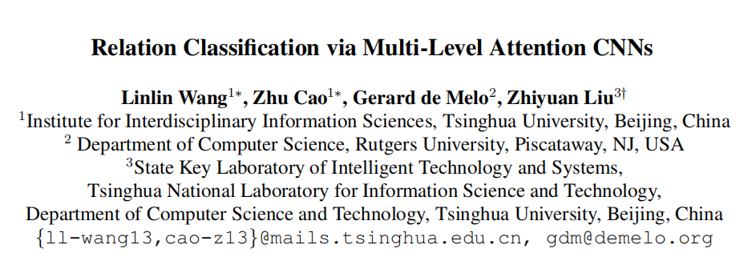
Related work 2: Linlin Wang; ACL; 2016
Main ideas (think about why this paper could be published, what particular problems the researchers solved, and why this approach outperforms other approaches at that time )
Their CNN architecture relies on a novel multi-level attention mechanism to capture both entity-specific attention and relation-specific pooling attention.
Introduce a novel pair-wise margin-based objective function that proves superior to standard loss functions
Notes:
将attention机制应用在输入序列中，用于学习输入语句中各部分对两个实体的注意力；
将attention机制应用在池化层上，用于学习目标类别的注意力；
改进了目标函数，使其在关系提取上表现得更好。

Slide 20
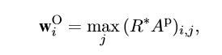
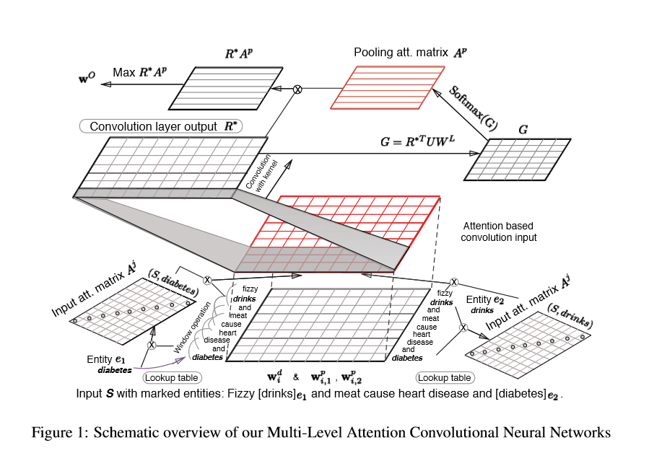
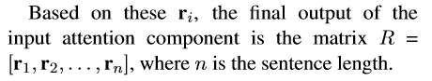
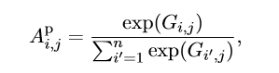
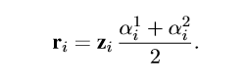
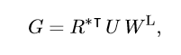
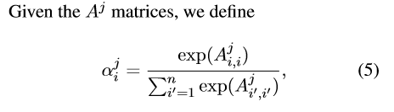
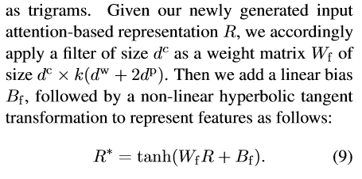
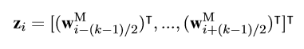
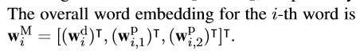

Slide 21
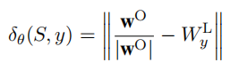
Related work 2: Linlin Wang; ACL; 2016
Data
SemEval-2010 Task 8 dataset，contains 10,717 sentences for nine types of annotated relations, a training set of 8,000 examples, and a test set with the remaining examples
Use the word2vec skip-gram model to learn initial word representations on Wikipedia. Other matrices are initialized with random values following a Gaussian distribution.
Objectives
Performance measurement: F1-score
Objective function:
Loss definition: , minimize the gap between predicted outputs and ground-truth labels, while maximizing the distance with the selected incorrect class
Models
Baseline: CR-CNN, SVM
SOTA Model: ATT-POOLING-CNN
Notes:
整个网络的输出应该是将编码后的输入序列映射在实体关系空间中的向量，同样地，网络也会学习出对应每一类实体关系的向量。基于这两个向量，文章提出了一种距离函数.
其中δθ(S,y)表示预测的输出与ground truth之间的距离，δθ(S,y^−)表示预测的输出与所有错误类别中得分最高的那个类别的距离。最后一项为正则项。

Slide 22
Related work 2: Linlin Wang; ACL; 2016
Results
Their full dual attention model Att-Pooling-CNN achieves an even more favorable F1-score of 88%.
Limitations
Some phrase does not appear in the training data, and moreover is used metaphorically, rather than in its original sense of turning around, making it difficult for the model to recognize the semantic connection
Implicit relationships that are not clearly helpful in certain contexts are also quite error-prone, More informative word embeddings could conceivably help in such cases
Notes:
对于在训练集中未出现的，或者使用比喻性用法时，出错可能性比较大；
对于一些上下文没有明显帮助的隐式关系，也较为容易出错，而更加丰富的词嵌入可能会对这种情况有帮助。

Slide 23
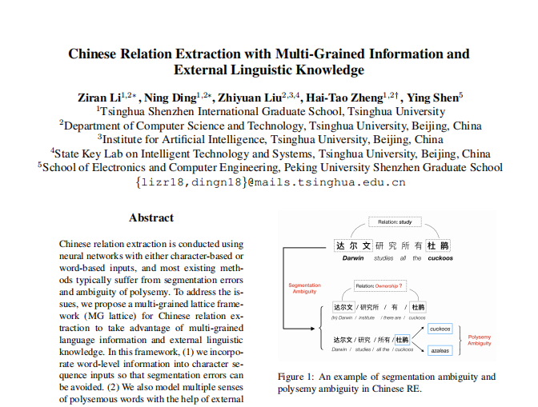
Related work 3: Ziran Li; ACL; 2019
Main ideas (think about why this paper could be published, what particular problems the researchers solved, and why this approach outperforms other approaches at that time )
uses a lattice-based structure to dynamically integrate word-level features into the character-based method.
model multiple senses of polysemous words with the help of external linguistic knowledge

Slide 24
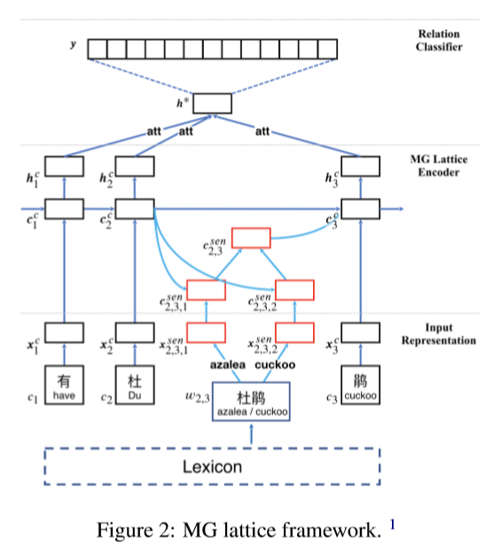
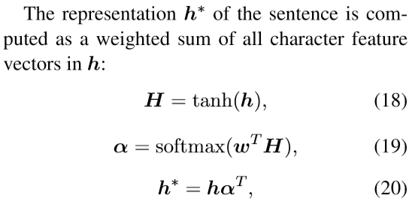
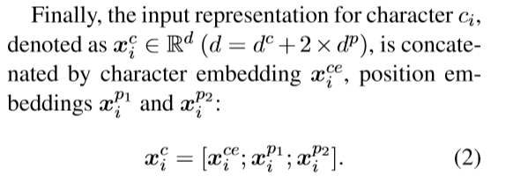

Slide 25
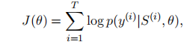
Related work 3: Ziran Li; ACL; 2019
Data
Chinese SanWen , ACE 2005 Chinese corpus, (LDC2006T06) and FinRE
The Chinese SanWen dataset contains 9 types of relations among 837 Chinese literature articles, in which 695 articles for training, 84 for testing and the rest 58 for validating
The ACE 2005 dataset is containing 8023 relation facts with 18 relation subtypes. Randomly select 75% of it to train the models and the remaining is used for evaluation.
The FinRE dataset from 2647 financial news in Sina Finance 2, with 13486, 3727 and 1489 relation instances for training, testing and validation respectively.
Objectives
Metrics: precision-recall curve, F1-score, Precision at top N predictions (P@N) and area under the curve (AUC)
Loss definition: (S is sentence, y is the estimated probability for each type.)
Models
Baseline: Word-Based, Char-based(CNN, BLSTM, PCNN)
SOTA: MG lattice model

Slide 26
Related work 3: Ziran Li; ACL; 2019
Results
Lattice-based models significantly outperform other proposed models on datasets from different domains.
The gap between the basic lattice model and the MG lattice model becomes narrow on the dataset FinRE. (FinRE is constructed from financial report corpus, and the words of financial reports are often rigorous and unambiguous.)
Limitations
Although they have used word, sense and character information in the work, more level of information can be incorporated into the MG Lattice. From coarse to fine, sememe-level information can be intuitively valuable.

Slide 27

Related work 4: Tsu-Jui Fu; ACL; 2019
Main ideas (think about why this paper could be published, what particular problems the researchers solved, and why this approach outperforms other approaches at that time )
Consider the interaction between named entities and relations via a 2nd-phase relation-weighted GCN to better extract relations
Linear and dependency structures are used to extract both sequential and regional features
Improve the word pair overlap
Notes:
一个端到端的关系抽取模型，来实现命名实体与关系的联合信息抽取。

Slide 28
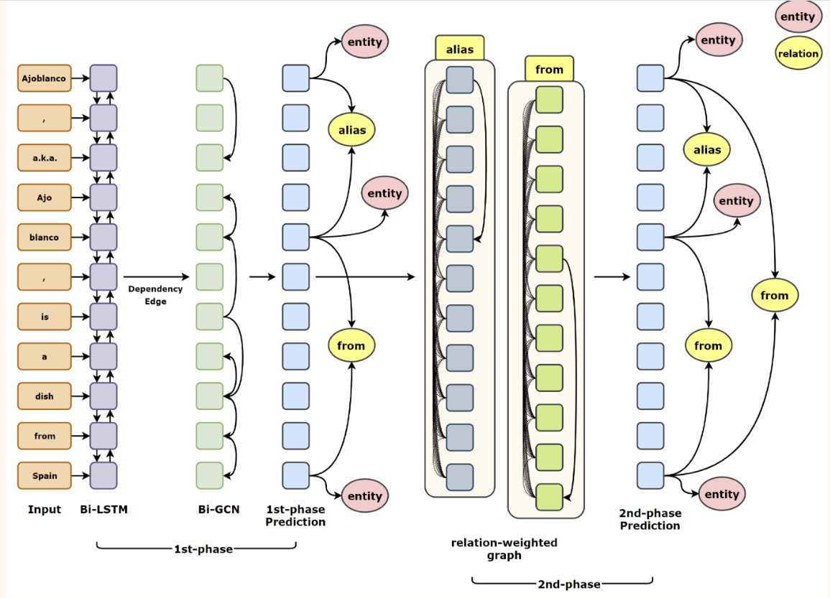

Slide 29
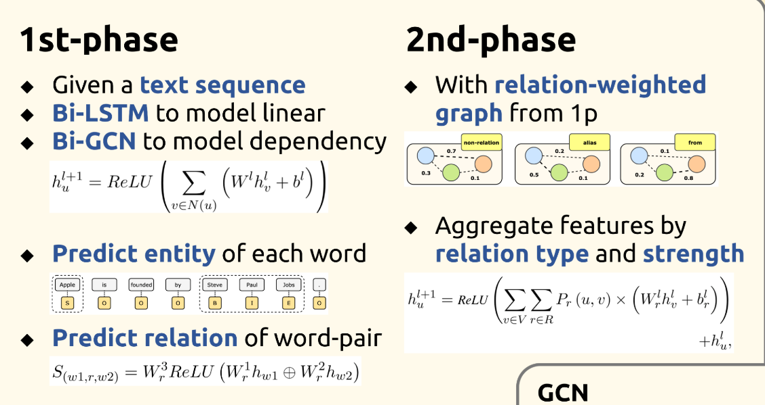

Slide 30
we propose a threshold prediction method, where all word pairs of an entity mention pair are still taken into account but in an independent fashion.
For example, if 2 of the 4 distributions have PresidentOf as the most probable class,thenthetriplet(Barack Obama,PresidentOf, United States) is extracted only if 2/4 = 50% > θ where θ is a free threshold parameter.

Slide 31
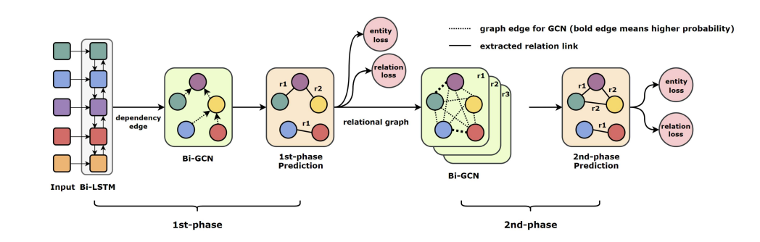

Slide 32
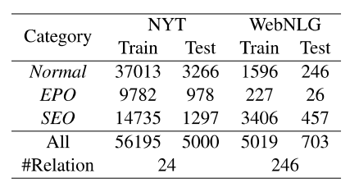
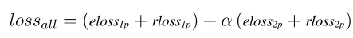
Related work 4: Tsu-Jui Fu; ACL; 2019
Data
NYT(filter sentences with more than 100 words), WebNLG(use only first sentences in each instance)
Entity label: (Begin, Inside, End, Single, Out), Relation label: (A one hot vector for each word pair)
Entity loss: cross-entropy, relation loss: cross-entropy
Objectives
Precision, Recall, F1
Loss definition
Models
Baseline: NovelTagging(LSTM), MultiDecoder
SOTA: GraphRel
Notes:
第一阶段应用BiLstm于GCN抽取序列性、区域性的词特征，输出对每个词预测三元组类别与实体类别。第二阶段对每个关系建立完整关系图

Slide 33
Related work 4: Tsu-Jui Fu; ACL; 2019
Results
Maintains both high precision and high recall
2nd-phased and one GCN layer is the best
Limitations
The model is a little complicated，2-nd phase need to create a graph for every relation, and in each graph the words are full-connected

Slide 34
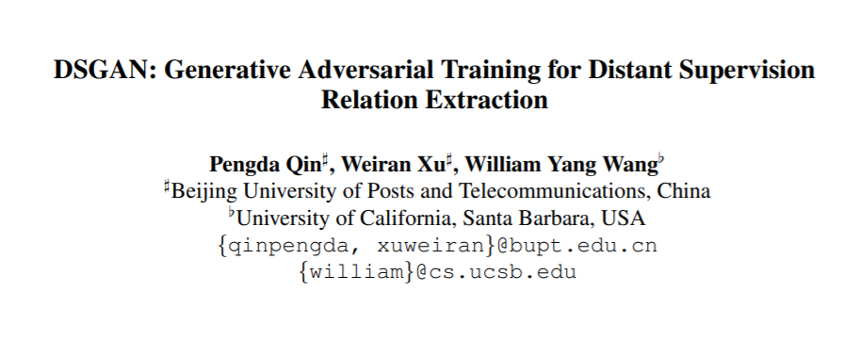
Related work 5: Pengda Qin; ACL; 2018
Main ideas (think about why this paper could be published, what particular problems the researchers solved, and why this approach outperforms other approaches at that time )
The first one to consider adversarial learning to denoise the distant supervision relation extraction dataset
The method is sentence-level and modelagnostic, so it can be used as a plug-and-play technique for any relation extractors
The method can generate a cleaned dataset without any supervised information
Notes:
用知识图谱中已有的三元组实例启发式地标注训练语料。远程监督思想的假设是，每个同时包含两个实体的句子，都表述了这两个实体在知识库中的对应关系。将知识图谱三元组中每个实体对看做待分类样例，将知识图谱中实体对关系看做分类标签。对于任何新的实体对，根据所出现该实体对的句子中抽取的特征，我们就可以利用该信息抽取系统自动判断其关系。远程监督能够根据知识图谱自动构建大规模标注语料库，因此取得了瞩目的信息抽取效果。

Slide 35
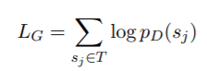
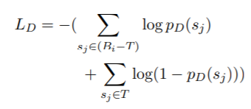
Related work 5: Pengda Qin; ACL; 2018
Data
Reidel dataset, New York Time dataset(a commonly-used distant supervision relation extraction dataset)
Label for Generator: positive/negative, label for Discriminator: low-confidence/high-confidence
Objectives
Performance measurement: PR curves, AUC value
Generator loss:
Discriminator loss:
Models
CNN+ONE, CNN+ATT, PCNN+ONE and PCNN+ATT
(CNN+ONE, CNN+ATT, PCNN+ONE and PCNN+ATT) + DSGAN

Slide 36
Related work 5: Pengda Qin; ACL; 2018
Results
obtain a generator that can recognize the true positive samples from the noisy distant supervision dataset
method can significantly improve the performances of many competitive baselines
Limitations
Need to train an extra GAN model.

Slide 37
How we can use these works in our tasks

Slide 38
Year | Author | Institution | Title | Scenario | Sample size |  | Model | Result
2016 | Yuxuan Wang, Jiang Guo, Wanxiang Che, Ting Liu | Harbin Institute of Technology | Transition-based Chinese Semantic Dependency Graph Parsing | semantic dependency parsing | 1,869,819+ 248,716 |  | Tree+SVM, List-based, Simplified | LF=61.24, UF=78.89
2016 | Linlin Wang , Zhu Cao , Gerard de Melo , Zhiyuan Liu | Tsinghua University | Relation Classification via Multi-Level Attention CNNs | Relation classification | 10,717 |  | Att-Pooling-CNN | F1 = 88.0
2018 | Tsu-Jui Fu,Peng Hsuan Li, Wei-Yun Ma | Academia Sinica | GraphRel:Modeling Text as Relational Graphs for Joint Entity and Relation Extraction | Joint Entity and Relation classification | 61,195+5722 |  | GraghRel | F1 = 61.9
2019 | Ziran Li , Ning Ding , Zhiyuan Liu , Hai-Tao Zheng , Ying Shen | Tsinghua University | Chinese Relation Extraction with Multi-Grained Information and External Linguistic Knowledge | Chinese relation extraction | 837+8,023+ 13,486 |  | MG Lattice | F1 = 78.17
2018 | Pengda Qin, Weiran Xu, William Yang Wang | Beijing University | DSGAN: Generative Adversarial Training for Distant SupervisionRelation Extraction | Distant Supervision Relation Extraction | 522,611 sentences, 281,270 entity pairs and 18,252 relational facts |  | (CNN+ONE, CNN+ATT, PCNN+ONE and PCNN+ATT) + DSGAN
Summary (for all the works you surveyed)

Slide 39
To do (what you planned to do next and why)
Build basic relation extraction model
Try to use the above algorithm to improve my model

Slide 40
Take-home message
Recently, CNN-based and LSTM-based model become mainstream.
Distant Supervision for relation extraction is popular at the moment.

